Slide 1
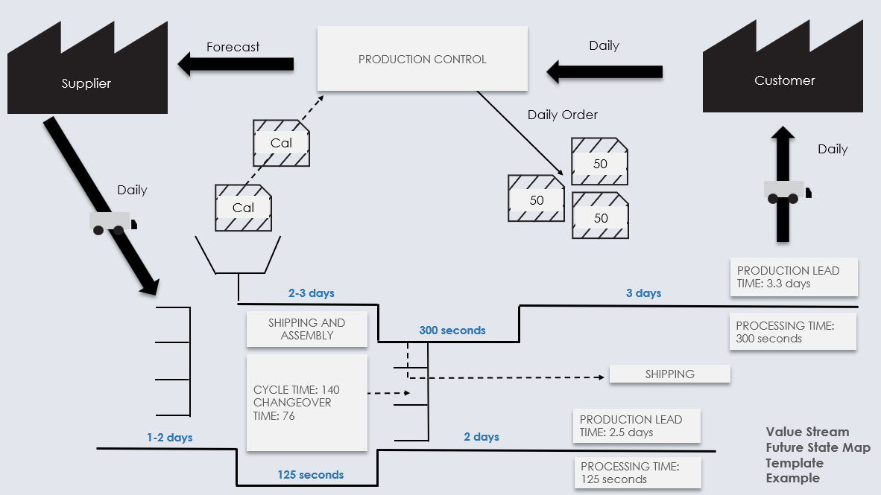
Value Stream Future State Map Template Example
Use this map to visualize the ideal process flow after improvements and optimizations are implemented. This is to illustrate the "after."
For descriptions, see VSM Icons Legend on Slide 5.
To create your own VSM, copy and paste icons from the VSM Icons on Slide 6.

Slide 2
Value Stream Future State Map
To create your own VSM, copy and paste icons from the VSM Icons on Slide 6.

Slide 3
NOTES

Slide 4
Forecast
PRODUCTION CONTROL
Daily
Supplier
Customer
Daily Order
Cal
Daily
50
Daily
Cal
50
50
PRODUCTION LEAD TIME: 3.3 days
2-3 days
3 days
SHIPPING AND ASSEMBLY
PROCESSING TIME: 300 seconds
300 seconds
CYCLE TIME: 140
CHANGEOVER TIME: 76
SHIPPING
PRODUCTION LEAD TIME: 2.5 days
1-2 days
2 days
Value Stream Future State Map Template Example
125 seconds
PROCESSING TIME: 125 seconds

Slide 6
Copy and paste the icons below to create your own VSM.

Slide 7
DISCLAIMER Any articles, templates, or information provided by Smartsheet on the website are for reference only. While we strive to keep the information up to date and correct, we make no representations or warranties of any kind, express or implied, about the completeness, accuracy, reliability, suitability, or availability with respect to the website or the information, articles, templates, or related graphics contained on the website. Any reliance you place on such information is therefore strictly at your own risk.

