Slide 1
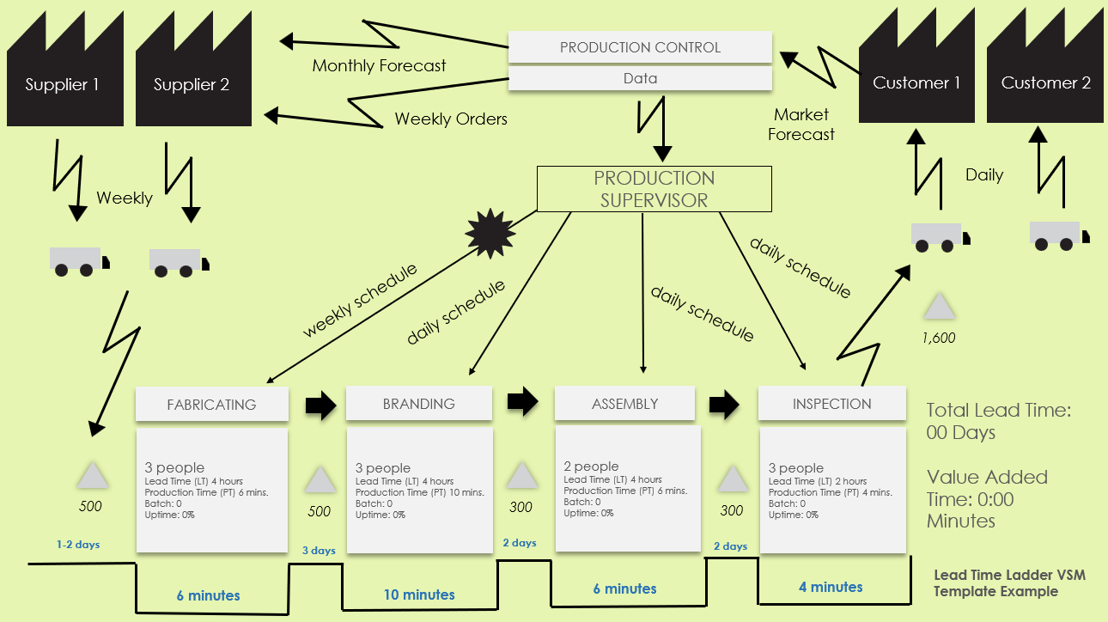
Lead Time Ladder VSM Template Example
Use this map to illustrate and track lead times and cycle times across different stages to identify delays and areas for speed improvement.
For descriptions, see VSM Icons Legend on Slide 5.
To create your own VSM, copy and paste icons from the VSM Icons on Slide 6.

Slide 2
Monthly Forecast
PRODUCTION CONTROL
Supplier 1
Supplier 2
Data
Customer 1
Customer 2
Weekly Orders
Market Forecast
PRODUCTION SUPERVISOR
Daily
Weekly
daily schedule
weekly schedule
daily schedule
daily schedule
1,600
FABRICATING
BRANDING
ASSEMBLY
INSPECTION
Total Lead Time: 00 Days
Value Added Time: 0:00 Minutes
3 people
Lead Time (LT) 4 hours
Production Time (PT) 6 mins.
Batch: 0
Uptime: 0%
3 people
Lead Time (LT) 4 hours
Production Time (PT) 10 mins.
Batch: 0
Uptime: 0%
2 people
Lead Time (LT) 4 hours
Production Time (PT) 6 mins.
Batch: 0
Uptime: 0%
3 people
Lead Time (LT) 2 hours
Production Time (PT) 4 mins.
Batch: 0
Uptime: 0%
500
500
300
300
1-2 days
3 days
2 days
2 days
Lead Time Ladder VSM Template Example
6 minutes
10 minutes
6 minutes
4 minutes

Slide 3
Lead Time Ladder VSM Template
To create your own VSM, copy and paste icons from the VSM Icons on Slide 6.

Slide 4
NOTES

Slide 6
Copy and paste the icons below to create your own VSM.

Slide 7
DISCLAIMER Any articles, templates, or information provided by Smartsheet on the website are for reference only. While we strive to keep the information up to date and correct, we make no representations or warranties of any kind, express or implied, about the completeness, accuracy, reliability, suitability, or availability with respect to the website or the information, articles, templates, or related graphics contained on the website. Any reliance you place on such information is therefore strictly at your own risk.

