Slide 1
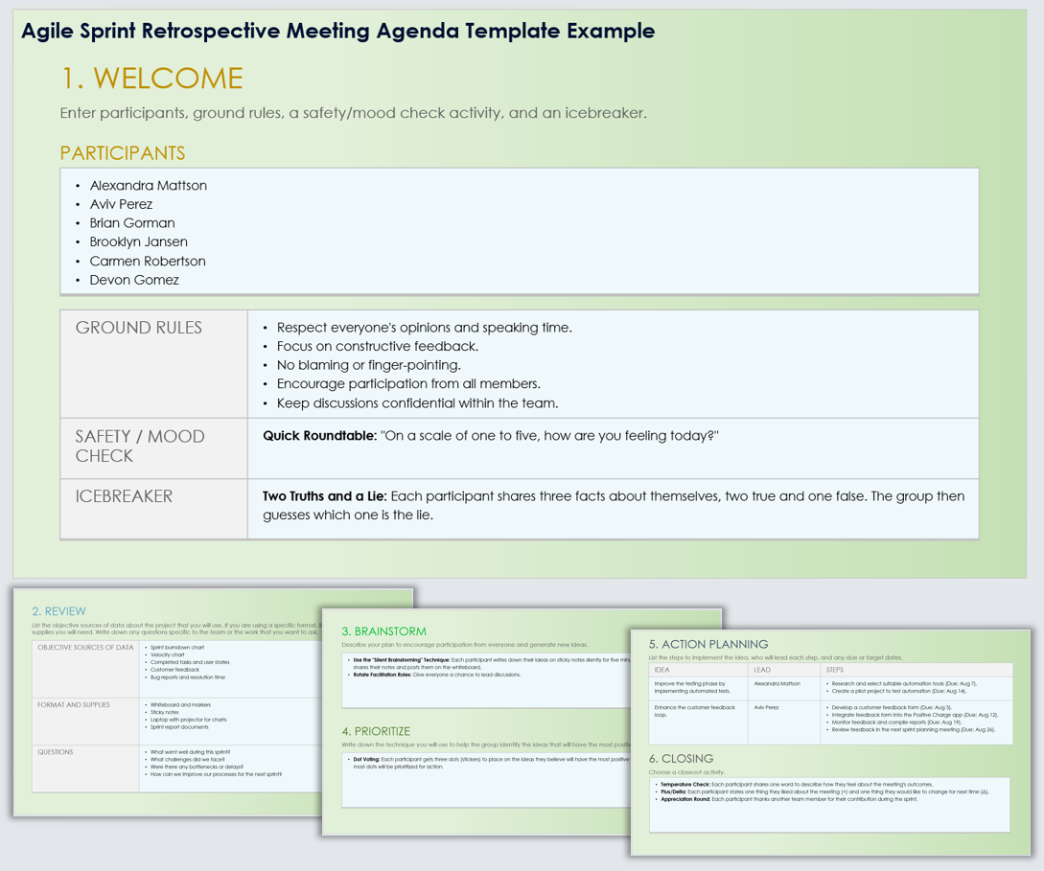
Agile Sprint Retrospective Meeting Agenda Template Example
When To Use This Template: Use this Agile sprint retrospective meeting agenda template to structure your sprint retrospective meetings. Doing so will help ensure that all participants engage and that the meeting covers essential topics like what went well, areas for improvement, brainstorming, and action planning.
Notable Templates Features: The template Includes sections for Welcome (including acknowledging Participants, Ground Rules, Safety/Mood Check, and playing an Icebreaker), a Review of the sprint, Brainstorming, a section to Prioritize ideas, Action Planning, and a meeting Closing activity.

Slide 2
Agile Sprint Retrospective Meeting Agenda Template Example
1. WELCOME
Enter participants, ground rules, a safety/mood check activity, and an icebreaker.
PARTICIPANTS
Alexandra Mattson Aviv Perez Brian Gorman Brooklyn Jansen Carmen Robertson Devon Gomez
GROUND RULES | Respect everyone's opinions and speaking time. Focus on constructive feedback. No blaming or finger-pointing. Encourage participation from all members. Keep discussions confidential within the team.
SAFETY / MOOD CHECK | Quick Roundtable: "On a scale of one to five, how are you feeling today?"
ICEBREAKER | Two Truths and a Lie: Each participant shares three facts about themselves, two true and one false. The group then guesses which one is the lie.

Slide 3
2. REVIEW
List the objective sources of data about the project that you will use. If you are using a specific format, list it here along with the supplies you will need. Write down any questions specific to the team or the work that you want to ask.
OBJECTIVE SOURCES OF DATA | Sprint burndown chart Velocity chart Completed tasks and user stories Customer feedback Bug reports and resolution time
FORMAT AND SUPPLIES | Whiteboard and markers Sticky notes Laptop with projector for charts Sprint report documents
QUESTIONS | What went well during this sprint? What challenges did we face? Were there any bottlenecks or delays? How can we improve our processes for the next sprint?

Slide 4
3. BRAINSTORM
Describe your plan to encourage participation from everyone and generate new ideas.
Use the "Silent Brainstorming" Technique: Each participant writes down their ideas on sticky notes silently for five minutes. Afterward, everyone shares their notes and posts them on the whiteboard. Rotate Facilitation Roles: Give everyone a chance to lead discussions.
4. PRIORITIZE
Write down the technique you will use to help the group identify the ideas that will have the most positive impact.
Dot Voting: Each participant gets three dots (stickers) to place on the ideas they believe will have the most positive impact. The ideas with the most dots will be prioritized for action.

Slide 5
5. ACTION PLANNING
List the steps to implement the idea, who will lead each step, and any due or target dates.
IDEA | LEAD | STEPS
Improve the testing phase by implementing automated tests. | Alexandra Mattson | Research and select suitable automation tools (Due: Aug 7). Create a pilot project to test automation (Due: Aug 14).
Enhance the customer feedback loop. | Aviv Perez | Develop a customer feedback form (Due: Aug 5). Integrate feedback form into the Positive Charge app (Due: Aug 12). Monitor feedback and compile reports (Due: Aug 19). Review feedback in the next sprint planning meeting (Due: Aug 26).
6. CLOSING
Choose a closeout activity.
Temperature Check: Each participant shares one word to describe how they feel about the meeting's outcomes. Plus/Delta: Each participant states one thing they liked about the meeting (+) and one thing they would like to change for next time (Δ). Appreciation Round: Each participant thanks another team member for their contribution during the sprint.

Slide 6
DISCLAIMER Any articles, templates, or information provided by Smartsheet on the website are for reference only. While we strive to keep the information up to date and correct, we make no representations or warranties of any kind, express or implied, about the completeness, accuracy, reliability, suitability, or availability with respect to the website or the information, articles, templates, or related graphics contained on the website. Any reliance you place on such information is therefore strictly at your own risk.

